Slide 1
If the human brain were so simple that we could understand it, we would be so simple that we couldn't.
—Emerson M. Pugh

Slide 2
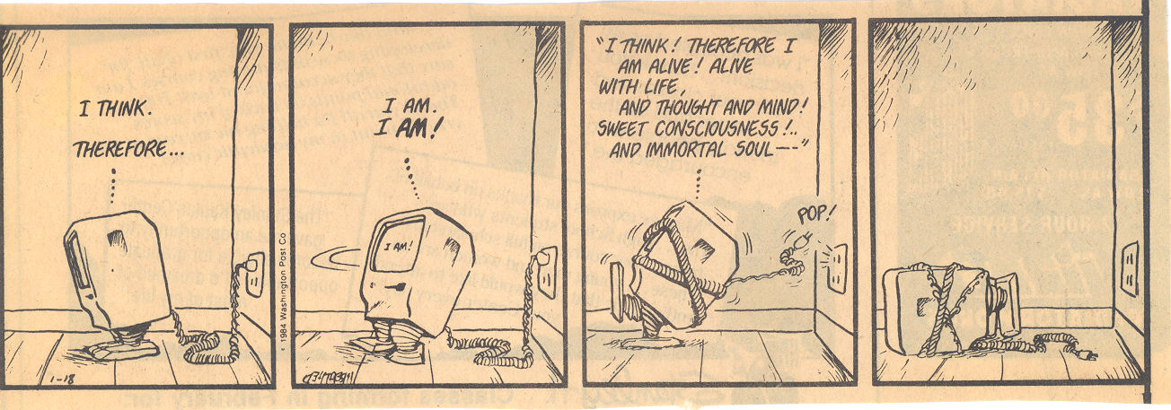
COMP 4230 Applied AI
Fall 2024
prof. stucki
Syllabus
Textbooks
Course web site
Software/platform

Slide 3
What is the difference?

Slide 4
Artificial Intelligence
Synthetic
Artificial
“The exciting new effort to make computers think…machines with minds, in the full and literal sense.” Haugeland, 1985
“The study of mental faculties through the use of computational models.”
Charniak and McDermott, 1985
Cognitive
“[The automation of] activities that we associate with human thinking, activities such as decision-making, problem solving, learning...” Bellman, 1978
“The study of the computations that make it possible to perceive, reason, and act.” Winston, 1992
“The art of creating machines that perform functions that require intelligence when performed by people.” Kurzweil, 1990
“Computational Intelligence is the study of the design of intelligent agents.”
Poole et al., 1998
Behavioral
“The study of how to make computers do things at which, at the moment, people are better.” Rich and Knight, 1991
“AI…is concerned with intelligent behavior in artifacts.” Nilsson, 1998
Engineering
Science

Slide 5
Components of AI
Knowledge Representation
Machine Learning
Automated Reasoning
Natural Language Processing
Vision & Perception
Agents & Robotics
Planning
Game Playing
Problem Solving

Slide 6
Academic Fields Impinging on AI
Computer Science
Philosophy
Psychology
Linguistics
Neuroscience
Anthropology
Mathematics & Logic
Genetics
Evolutionary Biology
Cognitive Science
Physics
Engineering
Business
Law & Ethics
Theology & Religion
Pharmacology
Quantum Physics
Dynamical Systems

Slide 7
The Representation Principle
Once a problem is described using an appropriate representation, the problem is almost solved.
–Patrick Henry Winston
Solving a problem simply means representing it so as to make the solution transparent.
–Herbert Simon

Slide 8
Einstein, “Hyperbolic Aesthetic” (1937)
Symbolic representation of qualitative entities is doomed to its rightful place of minor importance in a world where flowers and beautiful women abound.

